Slide 1
Time for a break
That’s the end of the quiz

Slide 2
Answers

Slide 3
Answer 1
What is the pope not allowed to do with his body?
Indulge in “self pleasure”
Have piercings
Have tattoo’s
Donate an organ

Slide 4
Answer 1
What is the pope not allowed to do with his body?
Indulge in “self pleasure”
Have piercings
Have tattoo’s
Donate an organ

Slide 5
Answer 2
The first line of CONPLANN 8888, the US government’s strategy for defending against zombies, states what?
This plan can be used during a pandemic
This plan is intended for unprecedented events in the future
This plan was inspired by a movie
This plan was not actually designed as a joke

Slide 6
Answer 2
The first line of CONPLANN 8888, the US government’s strategy for defending against zombies, states what?
This plan can be used during a pandemic
This plan is intended for unprecedented events in the future
This plan was inspired by a movie
This plan was not actually designed as a joke

Slide 7
Answer 3
Your cat is more likely to like you if you do what?
Play with them
Blink at them
Blow on them
Make purring noises

Slide 8
Answer 3
Your cat is more likely to like you if you do what?
Play with them
Blink at them
Blow on them
Make purring noises

Slide 9
Answer 4
In 2011, The Chambers Dictionary defined what as 'a cake, long in shape but short in duration‘?
eccles
éclair
gâteau au yaourt
sękacz

Slide 10
Answer 4
In 2011, The Chambers Dictionary defined what as 'a cake, long in shape but short in duration‘?
eccles
éclair
gâteau au yaourt
sękacz

Slide 11
Answer 5
Which is the most visited country in the world?
USA
Cambodia
France
UK

Slide 12
Answer 5
Which is the most visited country in the world?
USA
Cambodia
France
UK

Slide 13
Answer 6
A tree which has darker leaves than surrounding trees can indicate what
There’s a dead body buried beneath it
It is a favoured spot for later animals to urinate
It is located over a fresh water source
It is getting less sunlight

Slide 14
Answer 6
A tree which has darker leaves than surrounding trees can indicate what
There’s a dead body buried beneath it
It is a favoured spot for later animals to urinate
It is located over a fresh water source
It is getting less sunlight

Slide 15
Answer 7
A Thai national park was tired of tourists leaving their trash around campsites, so has recently started
Building temples with the bottles
Having bonefire weekends for locals
Recycling into “do not litter” signs
Mailing it back to its original owners,

Slide 16
Answer 7
A Thai national park was tired of tourists leaving their trash around campsites, so has recently started
Building temples with the bottles
Having bonefire weekends for locals
Recycling into “do not litter” signs
Mailing it back to its original owners,
with a note that says "you forgot something at Khao Yai National Park".

Slide 17
Answer 8
In 1954, Ernest Hemingway survived two plane crashes in two days. After the second crash, the writer was presumed dead, but walked out of the jungle the next day, holding what.
His plane ticket
A severed finger
A baby chimpanzee
A bottle of gin

Slide 18
Answer 8
In 1954, Ernest Hemingway survived two plane crashes in two days. After the second crash, the writer was presumed dead, but walked out of the jungle the next day, holding what.
His plane ticket
A severed finger
A baby chimpanzee
A bottle of gin

Slide 19
Answer 9
Despite repeated campaigns to repeal the law, which of these is still illegal in Sweden?
spontaneous dancing.
mini skirts
busking
displaying the flag of any other country outside your home

Slide 20
Answer 9
Despite repeated campaigns to repeal the law, which of these is still illegal in Sweden?
spontaneous dancing. A dancing permit is still required.
mini skirts
busking
displaying the flag of any other country outside your home

Slide 21
Answer 10
It’s almost impossible to tickle yourself, but one exception is…
The soles of your feet
The roof of your mouth
Your armpits
Your upper ribs

Slide 22
Answer 10
It’s almost impossible to tickle yourself, but one exception is…
The soles of your feet
The roof of your mouth
Your armpits
Your upper ribs

Slide 23
Answer 11
True or False?
Women fall in love more times in their lifetime than men do

Slide 24
Answer 11
True or False?
Women fall in love more times in their lifetime than men do
FALSE

Slide 25
Answer 12
True or False?
There was a London society called The Farting Club whose members tried to ‘outfart’ each other

Slide 26
Answer 12
True or False?
There was a London society called The Farting Club whose members tried to ‘outfart’ each other
TRUE in the 1720s

Slide 27
Answer 13
True or False?
Eating polar bear liver can cause your skin to peel off and your hair to fall out.

Slide 28
Answer 13
True or False?
Eating polar bear liver can cause your skin to peel off and your hair to fall out.
TRUE

Slide 29
Answer 14
True or False?
In Japan, there’s a museum that is specifically for rocks that look like faces.

Slide 30
Answer 14
True or False?
In Japan, there’s a museum that is specifically for rocks that look like faces.
TRUE

Slide 31
Answer 15
True or False?
Queen Elizabeth II is older than the invention of chocolate chip cookies

Slide 32
Answer 15
True or False?
Queen Elizabeth II is older than the invention of chocolate chip cookies
TRUE

Slide 33
Question 16
True or False?
Bruce Forsythe was 14 days older than sliced bread

Slide 34
Question 16
True or False?
Bruce Forsythe was 14 days older than sliced bread
TRUE

Slide 35
Answer 17
True or False?
The Romans had hot dogs

Slide 36
Answer 17
True or False?
The Romans had hot dogs
TRUE
The Latin for hot dog is 'pastillum botello fartum'

Slide 37
Answer 18
True or False?
Languages that are spoken more quickly than English (like Spanish) contain more information per syllable than English.

Slide 38
Answer 18
True or False?
Languages that are spoken more quickly than English (like Spanish) contain more information per syllable than English.
FALSE
They actually contain less. Almost all languages transmit the same amount of information per unit time.

Slide 39
Answer 19
True or False?
The top native predator on the island of Montserrat is a chicken

Slide 40
Answer 19
True or False?
The top native predator on the island of Montserrat is a chicken
FALSE
It is a frog. However it is known in the local dialect as “the mountain chicken”

Slide 41
Answer 20
True or False?
88 percent of British people consider themselves to be among the nicest 50% of the population

Slide 42
Answer 20
True or False?
88 percent of British people consider themselves to be among the nicest 50% of the population
FALSE
It is actually 98 percent

Slide 43
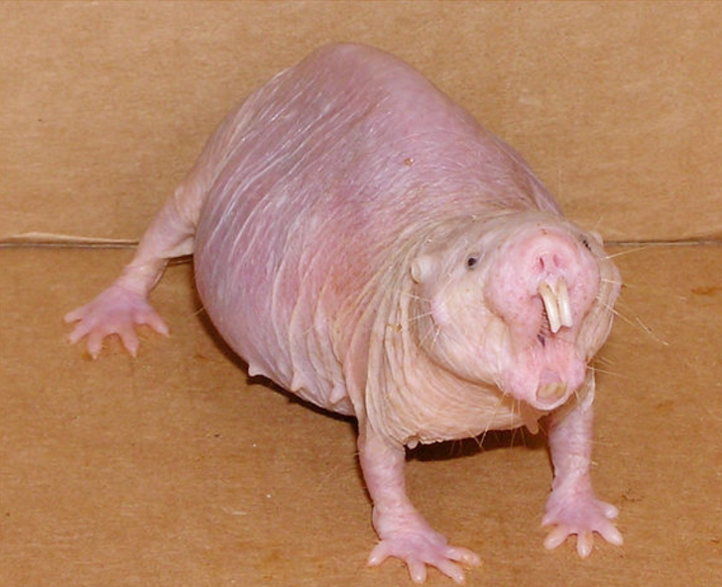
Question 21
What is this

Slide 44
Question 21
What is this
A Naked
Mole Rat

Slide 45
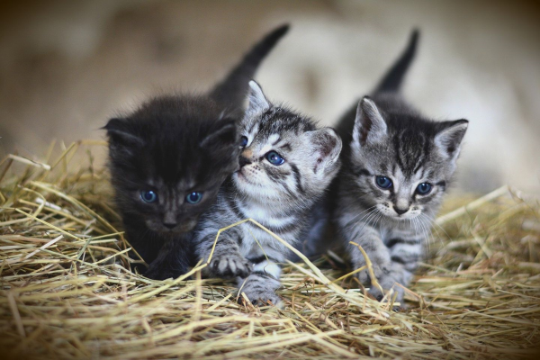
Question 22
What is a group of kittens called?

Slide 46
Question 22
What is a group of kittens called?
A Kindle

Slide 47
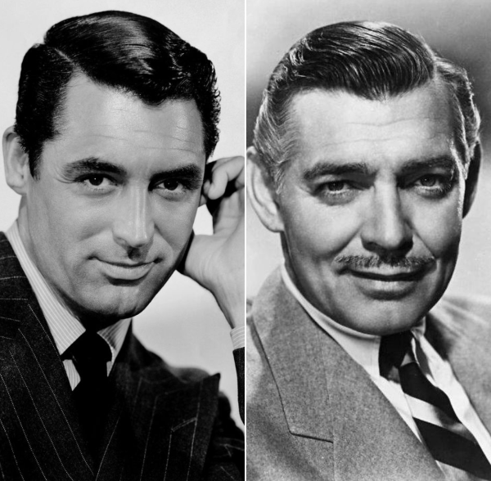
Question 23
True or False?
Cary Grant and Clark Gable met once a year to exchange unwanted monogrammed Christmas gifts

Slide 48
Question 23
True or False?
Cary Grant and Clark Gable met once a year to exchange unwanted monogrammed Christmas gifts
TRUE

Slide 49
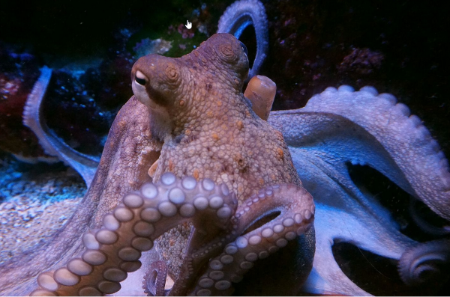
Question 24
True or False?
Octopus
sometimes
tickle fish

Slide 50
Question 24
True or False?
Octopus
sometimes
tickle fish
FALSE
But the do
punch them

Slide 51
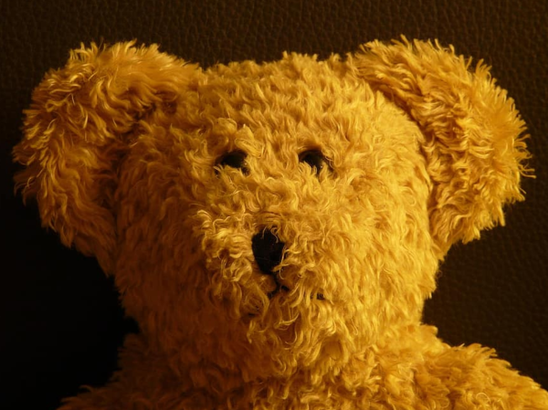
Question 25
What percentage of British adult say they still sleep with a cuddly toy
10%
25%
33%
50%

Slide 52
Question 25
What percentage of British adult say they still sleep with a cuddly toy
10%
25%
33%
50%

Slide 53
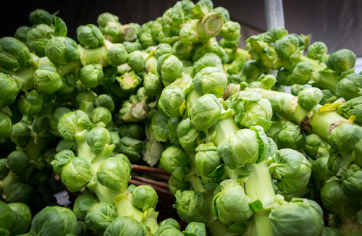
Question 26
True or false?
Brussels sprouts really did taste worse when you were a child

Slide 54
Question 26
True or false?
Brussels sprouts really did taste worse when you were a child
TRUE
Starting in the 1990s, Dutch growers of Brussels sprouts created new varietals that were much less bitter and much tastier

Slide 55
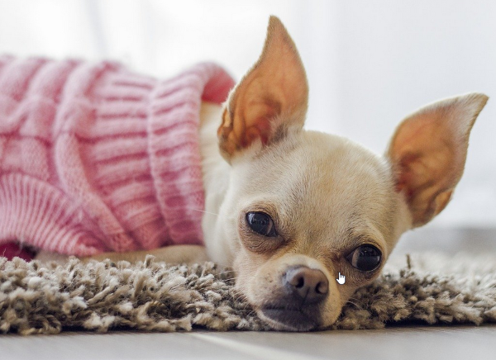
Question 27
True or false?
In 2019, a Spanish town was terrorized by a pack of wild chihuahuas.

Slide 56
Question 27
True or false?
In 2019, a Spanish town was terrorized by a pack of wild chihuahuas.
FALSE

Slide 57
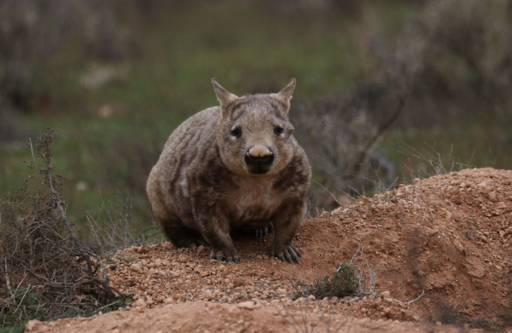
Question 28
What is this?

Slide 58
Question 28
What is this?
A wombat

Slide 59
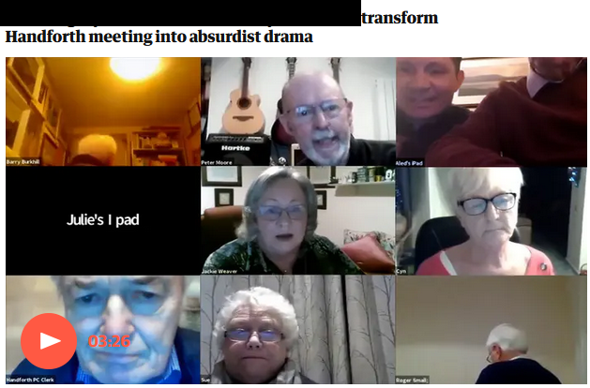
Question 29
What is missing from this headline

Slide 60

Question 29
What is missing from this headline

Slide 61
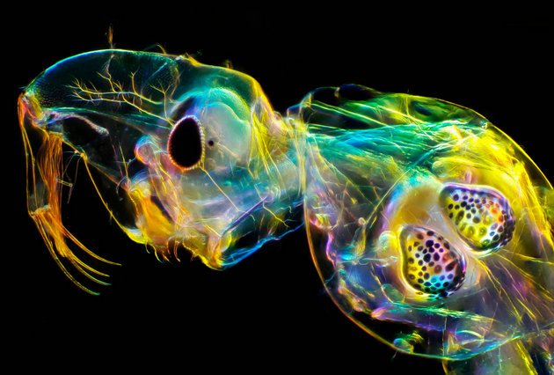
Question 30
True or false? This is a living organism

Slide 62
Question 30
TRUE it is a glass worm

Slide 63
Answer 31
The day recreational marijuana was legalised in a Canada, a 9 year old girl scout in Edmonton did what outside a newly opened weed shop?

Slide 64
Answer 31
The day recreational marijuana was legalised in a Canada, a 9 year old girl scout in Edmonton did what outside a newly opened weed shop?
sold all her cookies in 45 minutes

Slide 65
Answer 32
During the 1980s how many different singles took the UK chart number 1 spot?
Nearest one wins

Slide 66
Answer 32
During the 1980s how many different singles took the UK chart number 1 spot?
191

Slide 67
Answer 33
Occam’s broom is a term coined by the biologist Sidney Brenner to describe what?

Slide 68
Answer 33
Occam’s broom is a term coined by the biologist Sidney Brenner to describe what?
the process whereby inconvenient facts that don’t fit into one’s hypothesis are swept under the rug.

Slide 69
Answer 34
True or False?
Children are more likely to be arachnophobic after they watch a Spider-Man film

Slide 70
Answer 34
True or False?
Children are more likely to be arachnophobic after they watch a Spider-Man film
FALSE

Slide 71
Answer 35
True or False
Farts are strong enough to propel humans in zero gravity

Slide 72
Answer 35
True or False
Farts are strong enough to propel humans in zero gravity
FALSE
(attempts have been made).

Slide 73
Answer 36
True or False?
2021 will be the shortest year in nearly a century

Slide 74
Answer 36
True or False?
2021 will be the shortest year in nearly a century
TRUE
As the earth is rotating faster, it is predicted to be about 19 milliseconds shorter than the average year.

Slide 75
ANSWER 37
Wiltshire invested in a new fleet of gritters in late 2019. Which of these is not a gritters‘ chosen name?
Sir David Attenbrrrr
Thaw Enforcement
Gary Gritter
Spready Mercury

Slide 76
ANSWER 37
Wiltshire invested in a new fleet of gritters in late 2019. Which of these is not a gritters‘ chosen name?
Sir David Attenbrrrr
Thaw Enforcement
Gary Gritter
Spready Mercury

Slide 77
Answer 38
Which if these is a piece of advice from ‘The Rules of Dancing’, a book from 1529 about dance etiquette
Never fart when you are dancing
A smile is as important as proper footwear
Always glance your partners gaze
Bow low before dancing commences

Slide 78
Answer 38
Which if these is a piece of advice from ‘The Rules of Dancing’, a book from 1529 about dance etiquette
‘Never fart when you are dancing: grit your teeth and compel your arse to hold back the fart.’

Slide 79
ANSWER 39
The TV series Star Trek, first aired in 1967, has spawned nine television series and one short-form companion series that make up the bulk of the Star Trek mythos across 37 seasons of television
How many episodes are there is total?

Slide 80
ANSWER 39
The TV series Star Trek, first aired in 1967, has spawned nine television series and one short-form companion series that make up the bulk of the Star Trek mythos across 37 seasons of television
How many episodes are there is total?
797

Slide 81
Answer 40
True or False?
Smarter people drink more.

Slide 82
Answer 40
True or False?
Smarter people drink more.
OF COURSE IT IS TRUE

Slide 83
Question 41
Bonus question
It’s John Martin’s birthday on Wednesday.
How old will he be?

Slide 84
Question 41
Bonus question
It’s John Martin’s birthday on Wednesday.
How old will he be?
53

Slide 85
Thank you

